Slide 1


ARMSTRONG NUMBER & PALINDROME NUMBER
Prepared By:-
Name: MAKDANI HARSHIL DEWANG
Roll no: 348
Enrollment No: 21002171210073
Batch: 12
Branch: CSE

Slide 2
Aim
PL/SQL block to check whether an ‘entered number is Armstrong or not’ & ‘entered number is palindrome or not’ based on the input given by the user.

Slide 3
ARMSTRONG NUMBER
Any number of n digits which is equal to the sum of n^{th} power of digits in the number.
Some examples of ARMSTRONG NUMBER:-1,153,370,371,407…

Slide 4
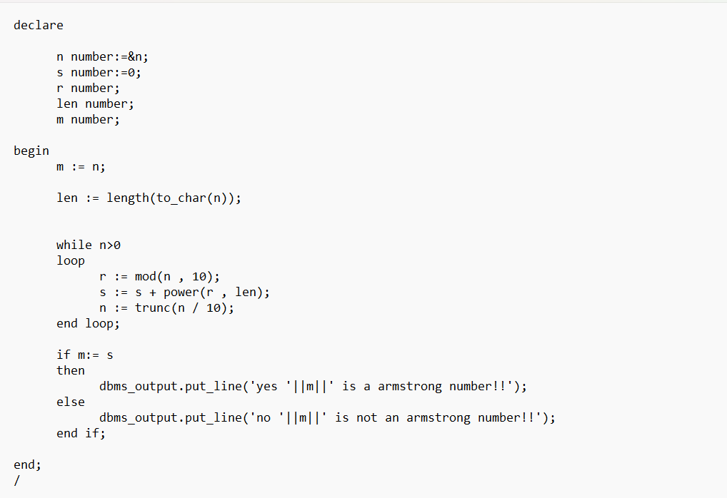
CODE FOR ARMSTRONG NUMBER

Slide 5
PALINDROME NUMBER
A ‘Palindrome number’ is a number that remains the same when its digits are reversed.
Examples of Palindrome Number:-101,121,656,12321,4986894…..

Slide 6
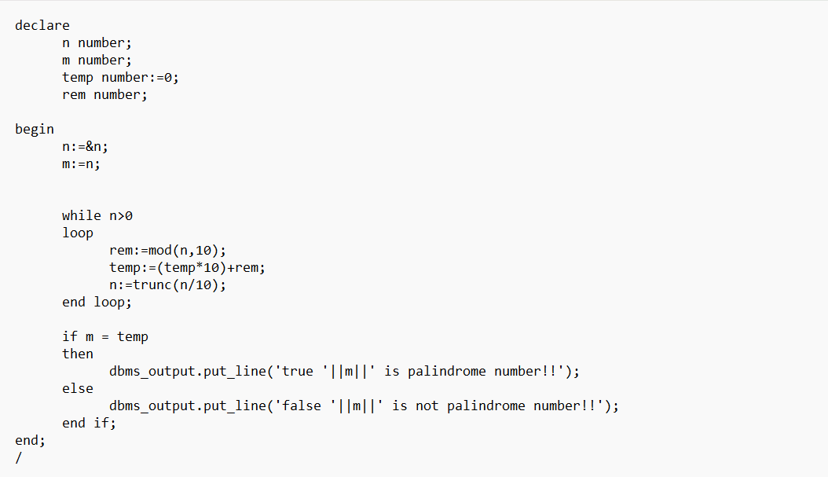
CODE FOR PALINDROME NUMBER

Slide 7
THANK YOU

